Slide 1
Optimal Medical Image Fusion with Improved Spectral Efficiency
Guided by :
Fousia M. Shamsudeen
Assistant professor
Dept. of MCA
Submitted by :
Surabhi S
S6 MCA

Slide 2
Contents
Introduction
Objective
Literature review
Methodology
Proposed System
Result Analysis
Conclusion
Reference

Slide 3
Introduction
Medical image fusion is the process of combining multiple images from single or multiple imaging modalities to improve the imaging quality and accuracy for the clinical applicability of medical images for diagnosis.
Preprocesses the input image (MRI) and reference image (PET) and under goes decimated wavelet transform. We use Haar as decimated image transformation.
Fuse approximation images based on weighted fusion and detailed images based on spectral fusion
Reconstruct image based on inverse haar.
Result analysis used here are Standard deviation and PSNR

Slide 4
Objective
Extract required data from noisy
Fuse medical images without any loss of data
Enhance them with properties of both input and reference images.
Analyze the result

Slide 5
Literature Review
MRI and PET Image Fusion Using Fuzzy Logic and Image Local Features (ScientificWorldJournal. 2014; Umer Javed, ^{1 , 2} Muhammad Mohsin Riaz, ³ Abdul Ghafoor, ^{3 ,*} Syed Sohaib Ali, ³ andTanveer Ahmed Cheema ²)
MRI and PET image fusion by combining IHS and retina-inspired models (Elsevier, April 2010, SabalanDaneshvar¹ , HassanGhassemian)
A new MRI and PET image fusion algorithm based on pulse coupled neural network (IEEE Xplore: 05 January 2015, Behzad Kalafje Nobariyan ; Sabalan Daneshvar ; Andia Foroughi)
PET and MRI brain image fusion using wavelet transform with structural information adjustment and spectral information patching (IEEE Xplore: 26 May 2014, Po-Whei Huang ; Cheng-I Chen ; Ping Chen ; Phen-Lan Lin ; Li-Pin Hsu)

Slide 6
Cntd…
5. MRI-PET Medical Image Fusion Technique by Combining Contourlet and Wavelet Transform (Third International Conference on Recent Trends in Information, Telecommunication and Computin, August 2012 , Ch.Hima Bindu1 and Dr.K.Satya Prasad2 )
6. Fusion of PET and MRI for Hybrid Imaging (January 2011, Zang-Hee Cho, Young-Don Son, Young-Bo Kim, and Seung-Schik Yoo)

Slide 7
Methodology
Image decomposition using haar discrete wavelet transform
Fuse detailed images using spectral fusion
Fuse approximation images using weighted fusion based on FPA optimization
Reconstruct images using inverse haar DWT

Slide 8
Decomposing images
Approximation
Detailed LH
Image
Detailed HL
Detailed HH

Slide 9
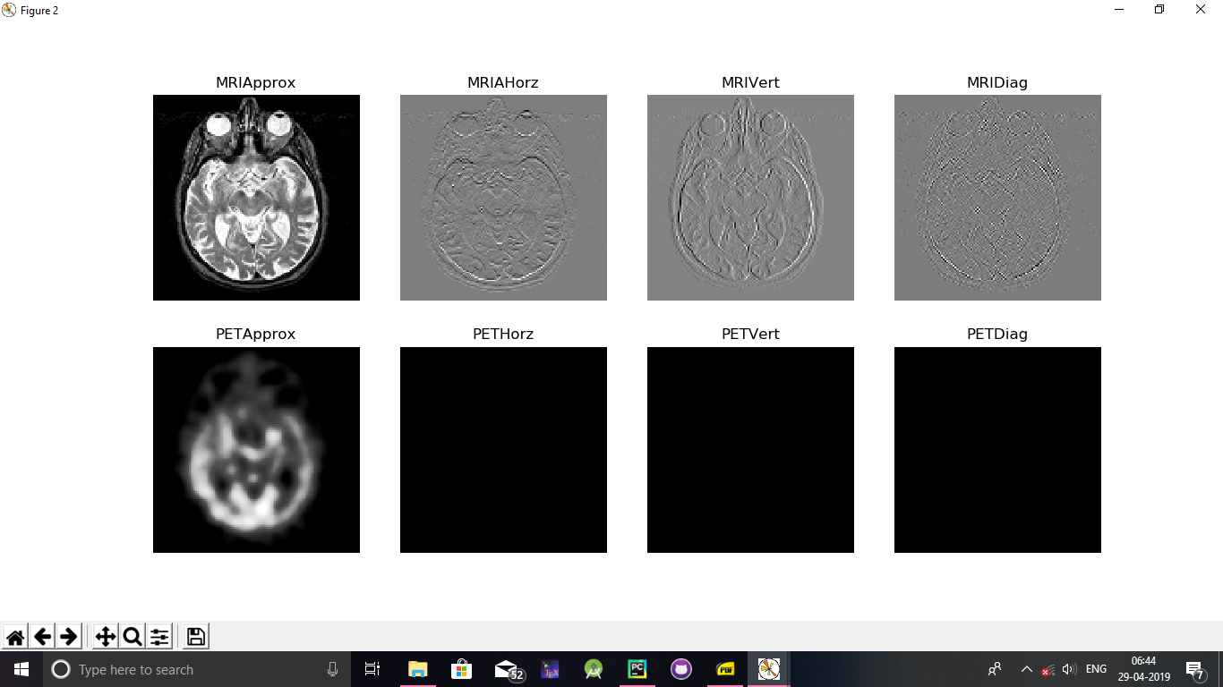

Slide 10
Cntd…
Transform can be of 2 types
Decimated
Undecimated
In Decimated transformation, it keeps only the relevant parts of information.
Eg . Haar, DCT( Discrete Cosine Transform)
In undecimated transformation, it keeps all the information including noise of input image after decomposition.
Eg. Wavelet, forier
Discrete wavelet transform extracts the edge information of the input image

Slide 11

Cntd…
Decomposition using Haar wavelet transform
First of all a Haar transform is created of size 4X4 and it is applied on the input image.
${\text{(}image ⊗{haar}^{T}\text{) }}^{T}$ $⊗{haar}^{T}$
But we can achieve this in python by simply calling a library function.
Thus we get an approximation and 3 detailed images as coefficients.
We use those coefficients for further image fusion.

Slide 12

Cntd…
Detailed image fusion using Spectral Fusion
Divide each image into a block of size 15 X15.
On each block , find square root of square of row wise difference and square of column wise difference , is called Spectral frequency
$SF= \sqrt{{(row diff)}^{2} − {(coll diff)}^{2}}$
compare SF of PET and MRI on each pixel.
if SF of MRI > SF of PET
Fused image = MRI
Else if SF of PET > SF of MRI
Fused image = PET
Else
Fused image = (PET+MRI)/2

Slide 13
Cntd…
Approximation image fusion based on FPA
Create an initial population
On each item in population , find optimal solution based on Global and Local solutions.
If global solution > local solution
Optimal solution = global solution
Else
Optimal solution = local solution

Slide 14

Cntd…
This optimal solution is further used for weighted image fusion.
$$C\left(x,y\right)=W∗C_{1}\left(x,y\right)+\left(1−W\right)∗C_{2}(x,y)$$
Where W is the optimal solution.

Slide 15
Proposed System
MRI
PET
Reconstruction
Preprocessed
decomposed
DWT - haar
MRI LL
MRI LH
PET LL
PET LH
Maximization
FPA
MRI HL
MRI HH
PET HL
PET HH
Adaptive fusion

Slide 16
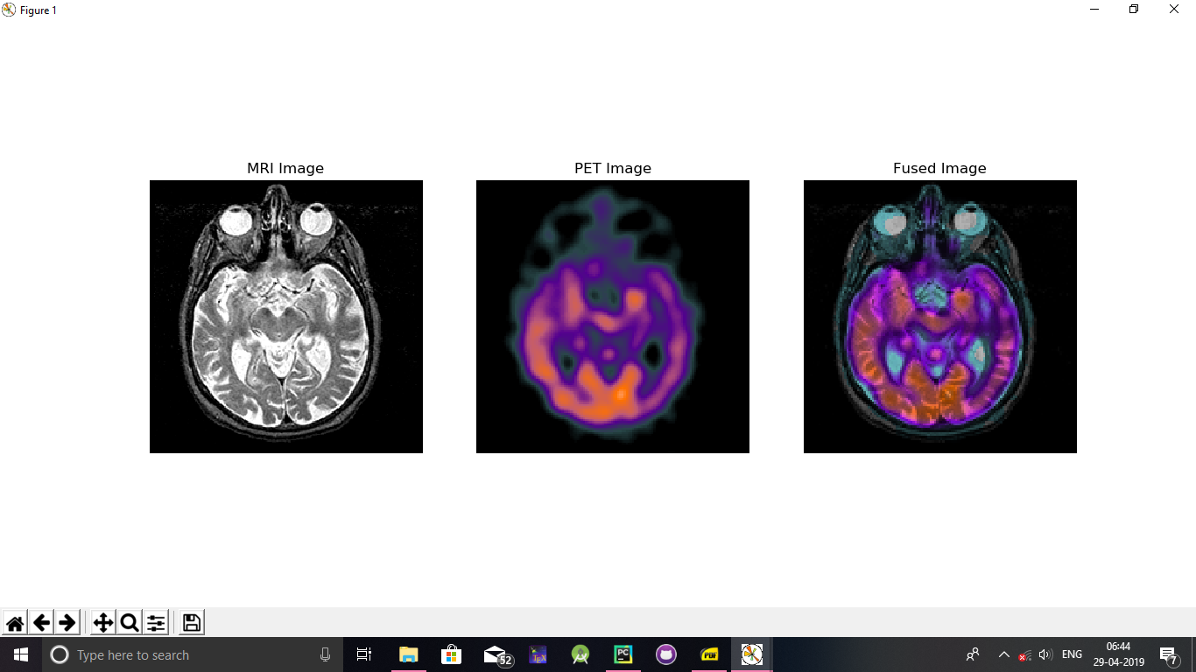
Result Analysis
certain screenshots of image fusion

Slide 17
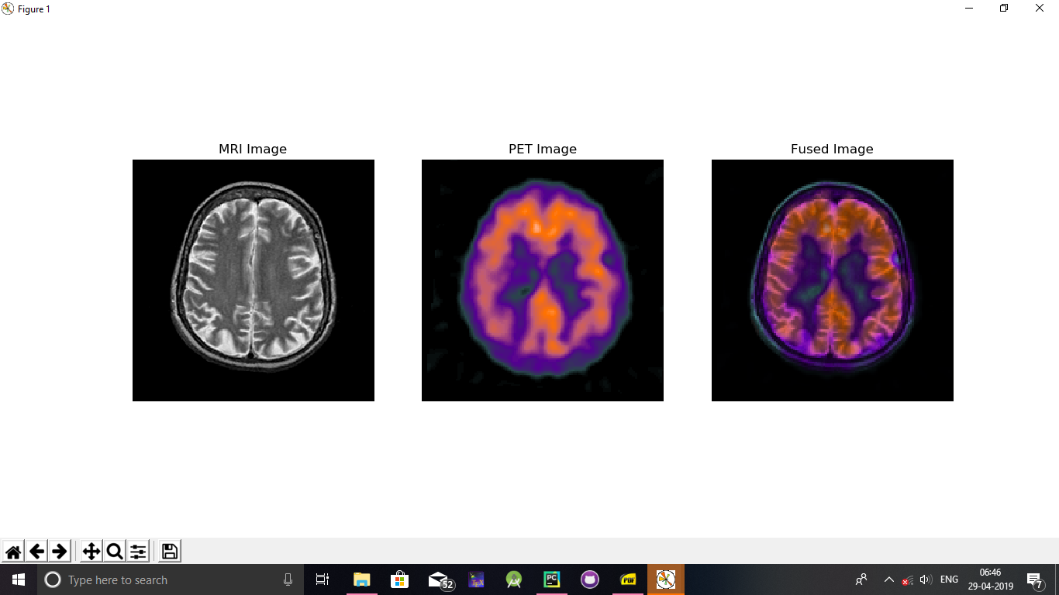

Slide 18
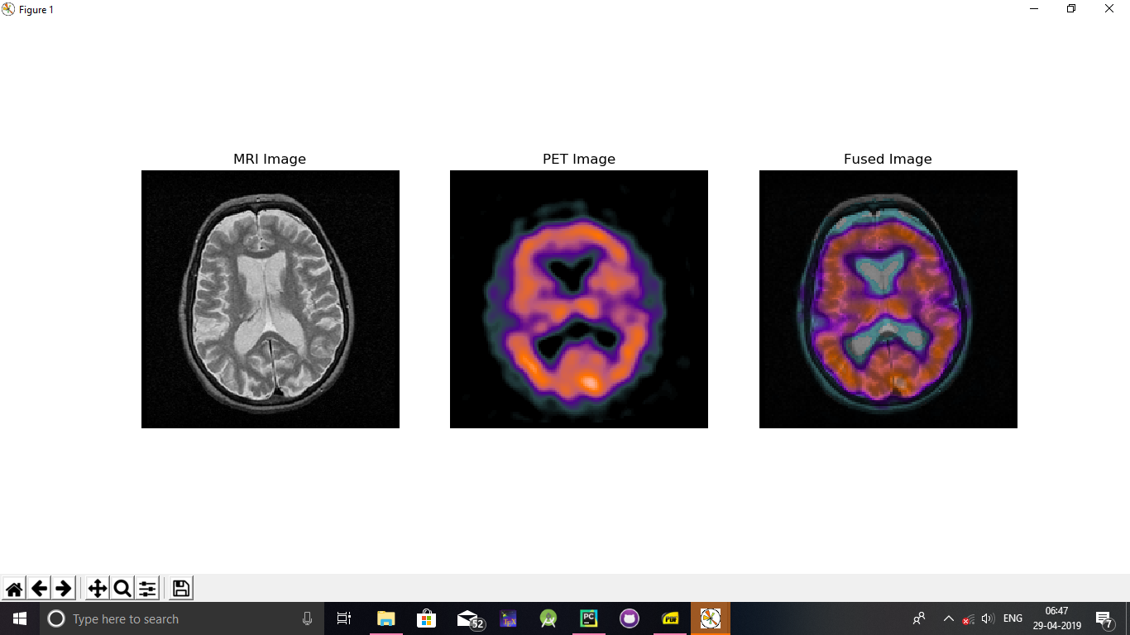

Slide 19
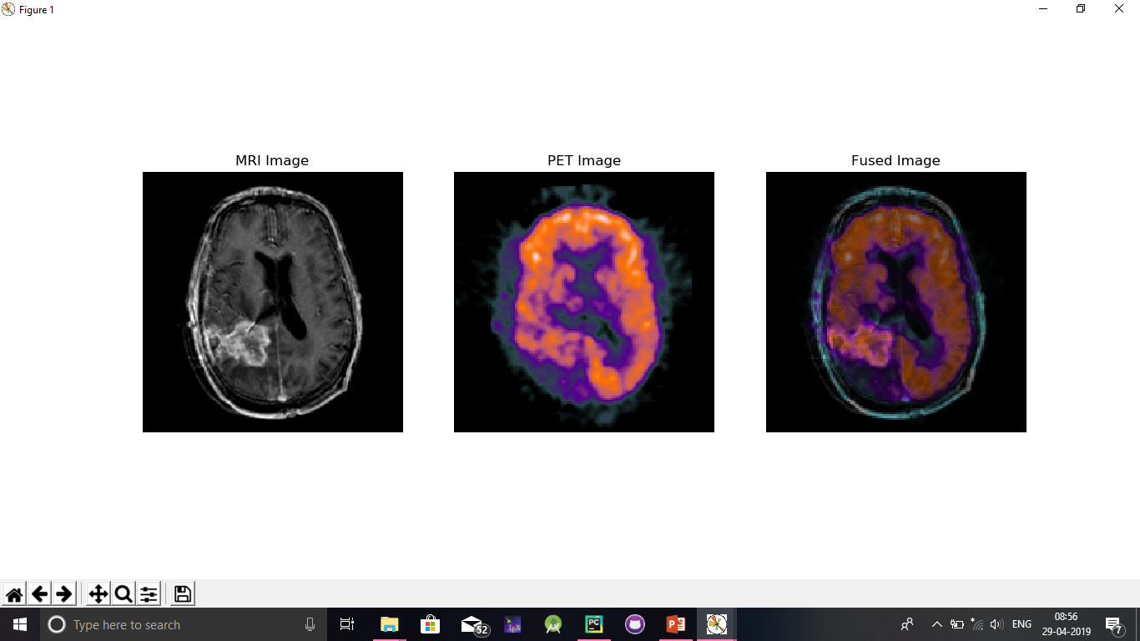

Slide 20
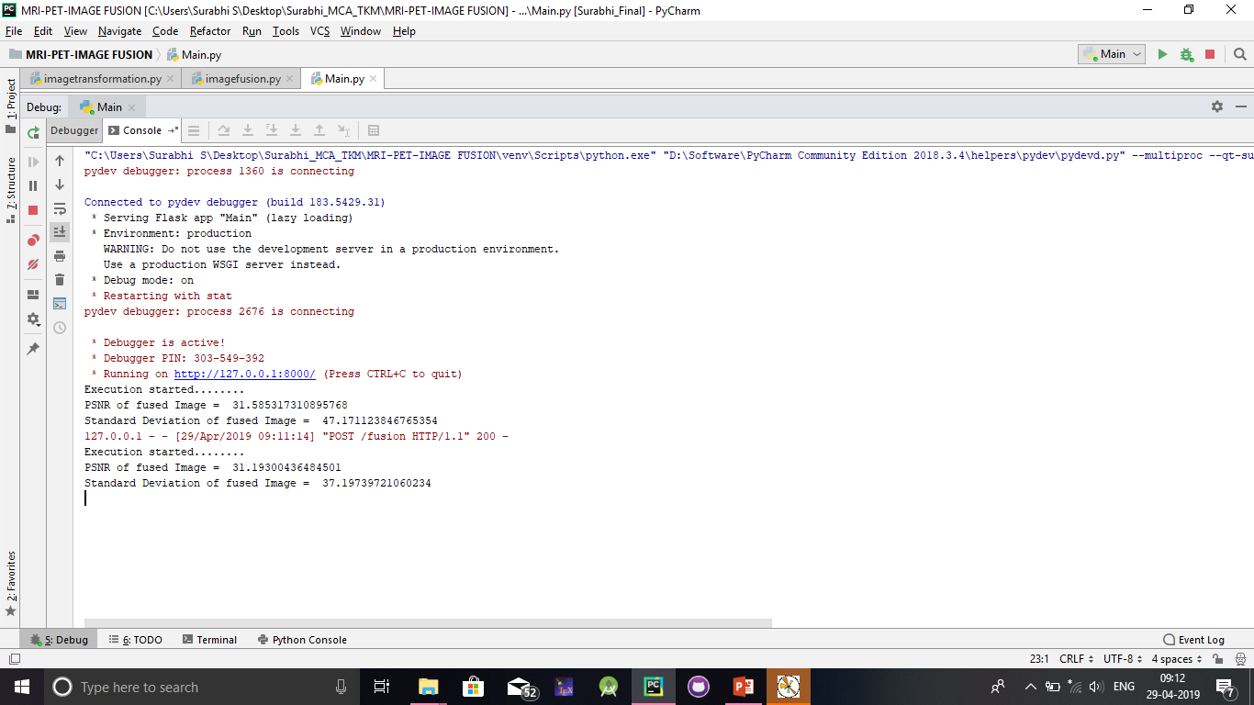
In our project we calculate PSNR as well as standard deviation of the image
PSNR – peak signal to noise ratio is better when its value is higher.

Slide 21
Conclusion
In this project we have improved the psnr value and sd value than other traditional methods.
Reduced the noisy content in an effective way.
Here we used the best approach to extract the information ie, haar transform.
But we can further make improvement in case of weighted fusion. The weight value we used here is from a predefined population.
This may be different to certain images.

Slide 22
References
Daubechies (Ten lectures on wavelets; Orthonormal Bases of Compactly Supported Wavelets) 1993
Basics of wavelets transform ,DWT.
http://shodhganga.inflibnet.ac.in/bitstream/10603/20682/12/12_chapter%203.pdf
- Details of haar transform and image decomposition
Flower Pollination Algorithm for Global Optimization (International Conference on Unconventional Computing and Natural Computation
Authors: Xin-She Yang, Springer-Verlag Berlin Heidelberg 2012)
- Flower pollination optimization algorithm
4. Fusion of PET and CT images using wavelet transform (Hellenic Journal of Nuclear Medicine September - December 2009, Bahareh Shalchian 1 PhD, Hossein Rajabi 1 PhD, Hamid Soltanian-zadeh 2 PhD)
A PPLICATION O F I MAGE F USION F OR E NHANCINGT HE Q UALITY O F A N I MAGE (Suman Deb 1 , Saptarshi Chakraborty 2 , Taniya Bhattacharjee 3, Assistant professor, Computer Science & Engg Dept, NIT Agartala.)
A New Method to Medical MRI Images Restoration with Swarm Intelligence (INTERNATIONAL JOURNAL OF COMPUTERS Volume 12, 2018)

Slide 23
Thank You

